Slide 1

Milestones Report September – November 2023
Center for Health and Medical Services

Slide 2
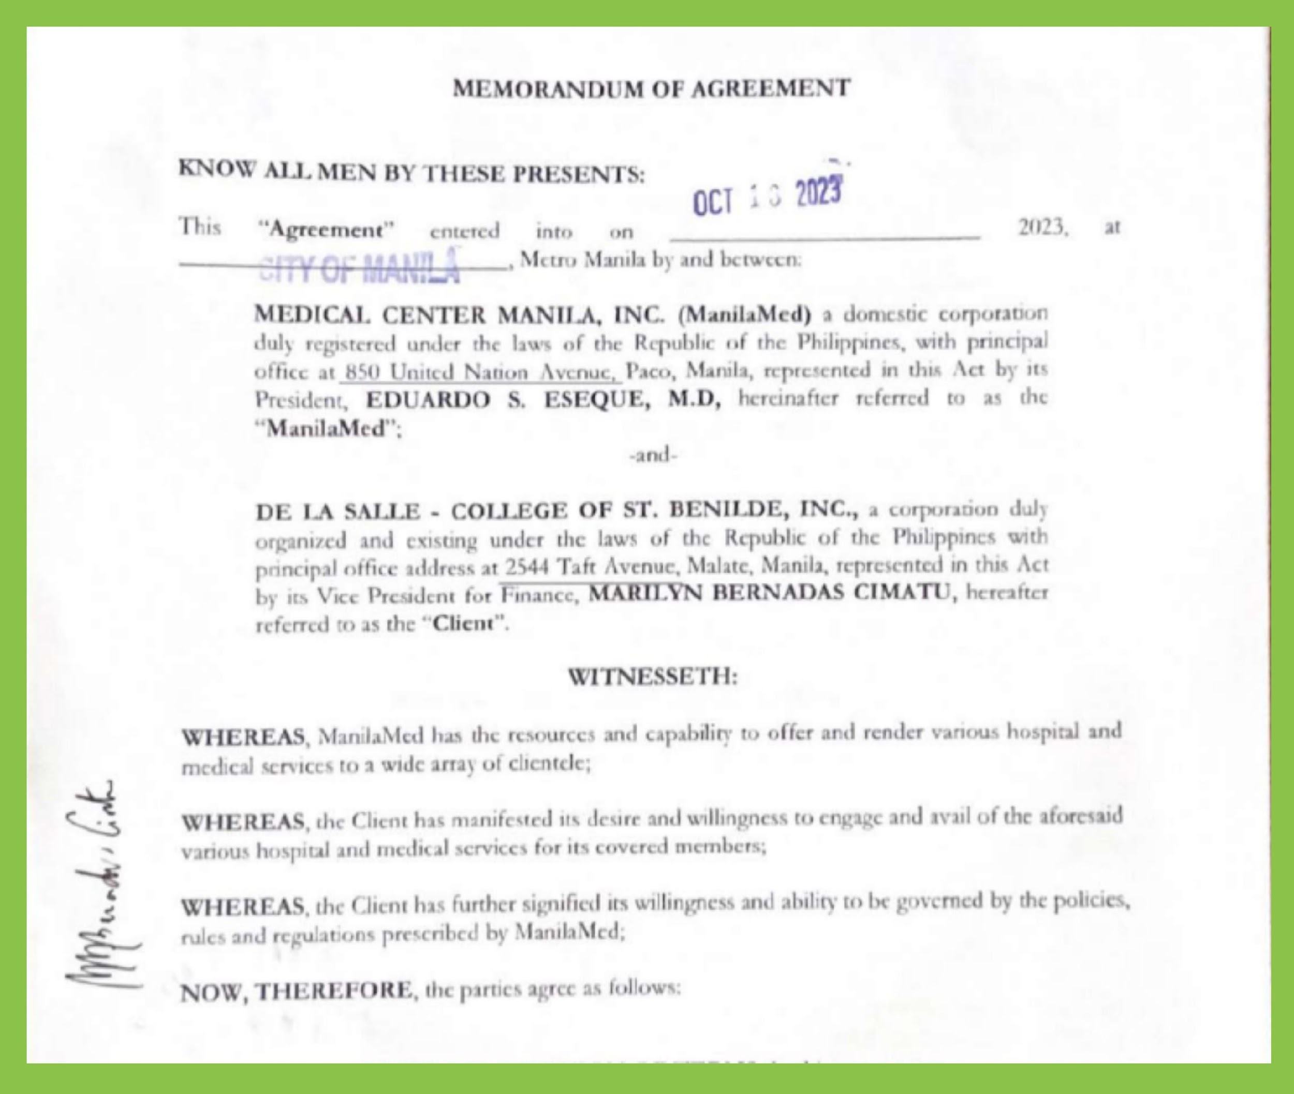
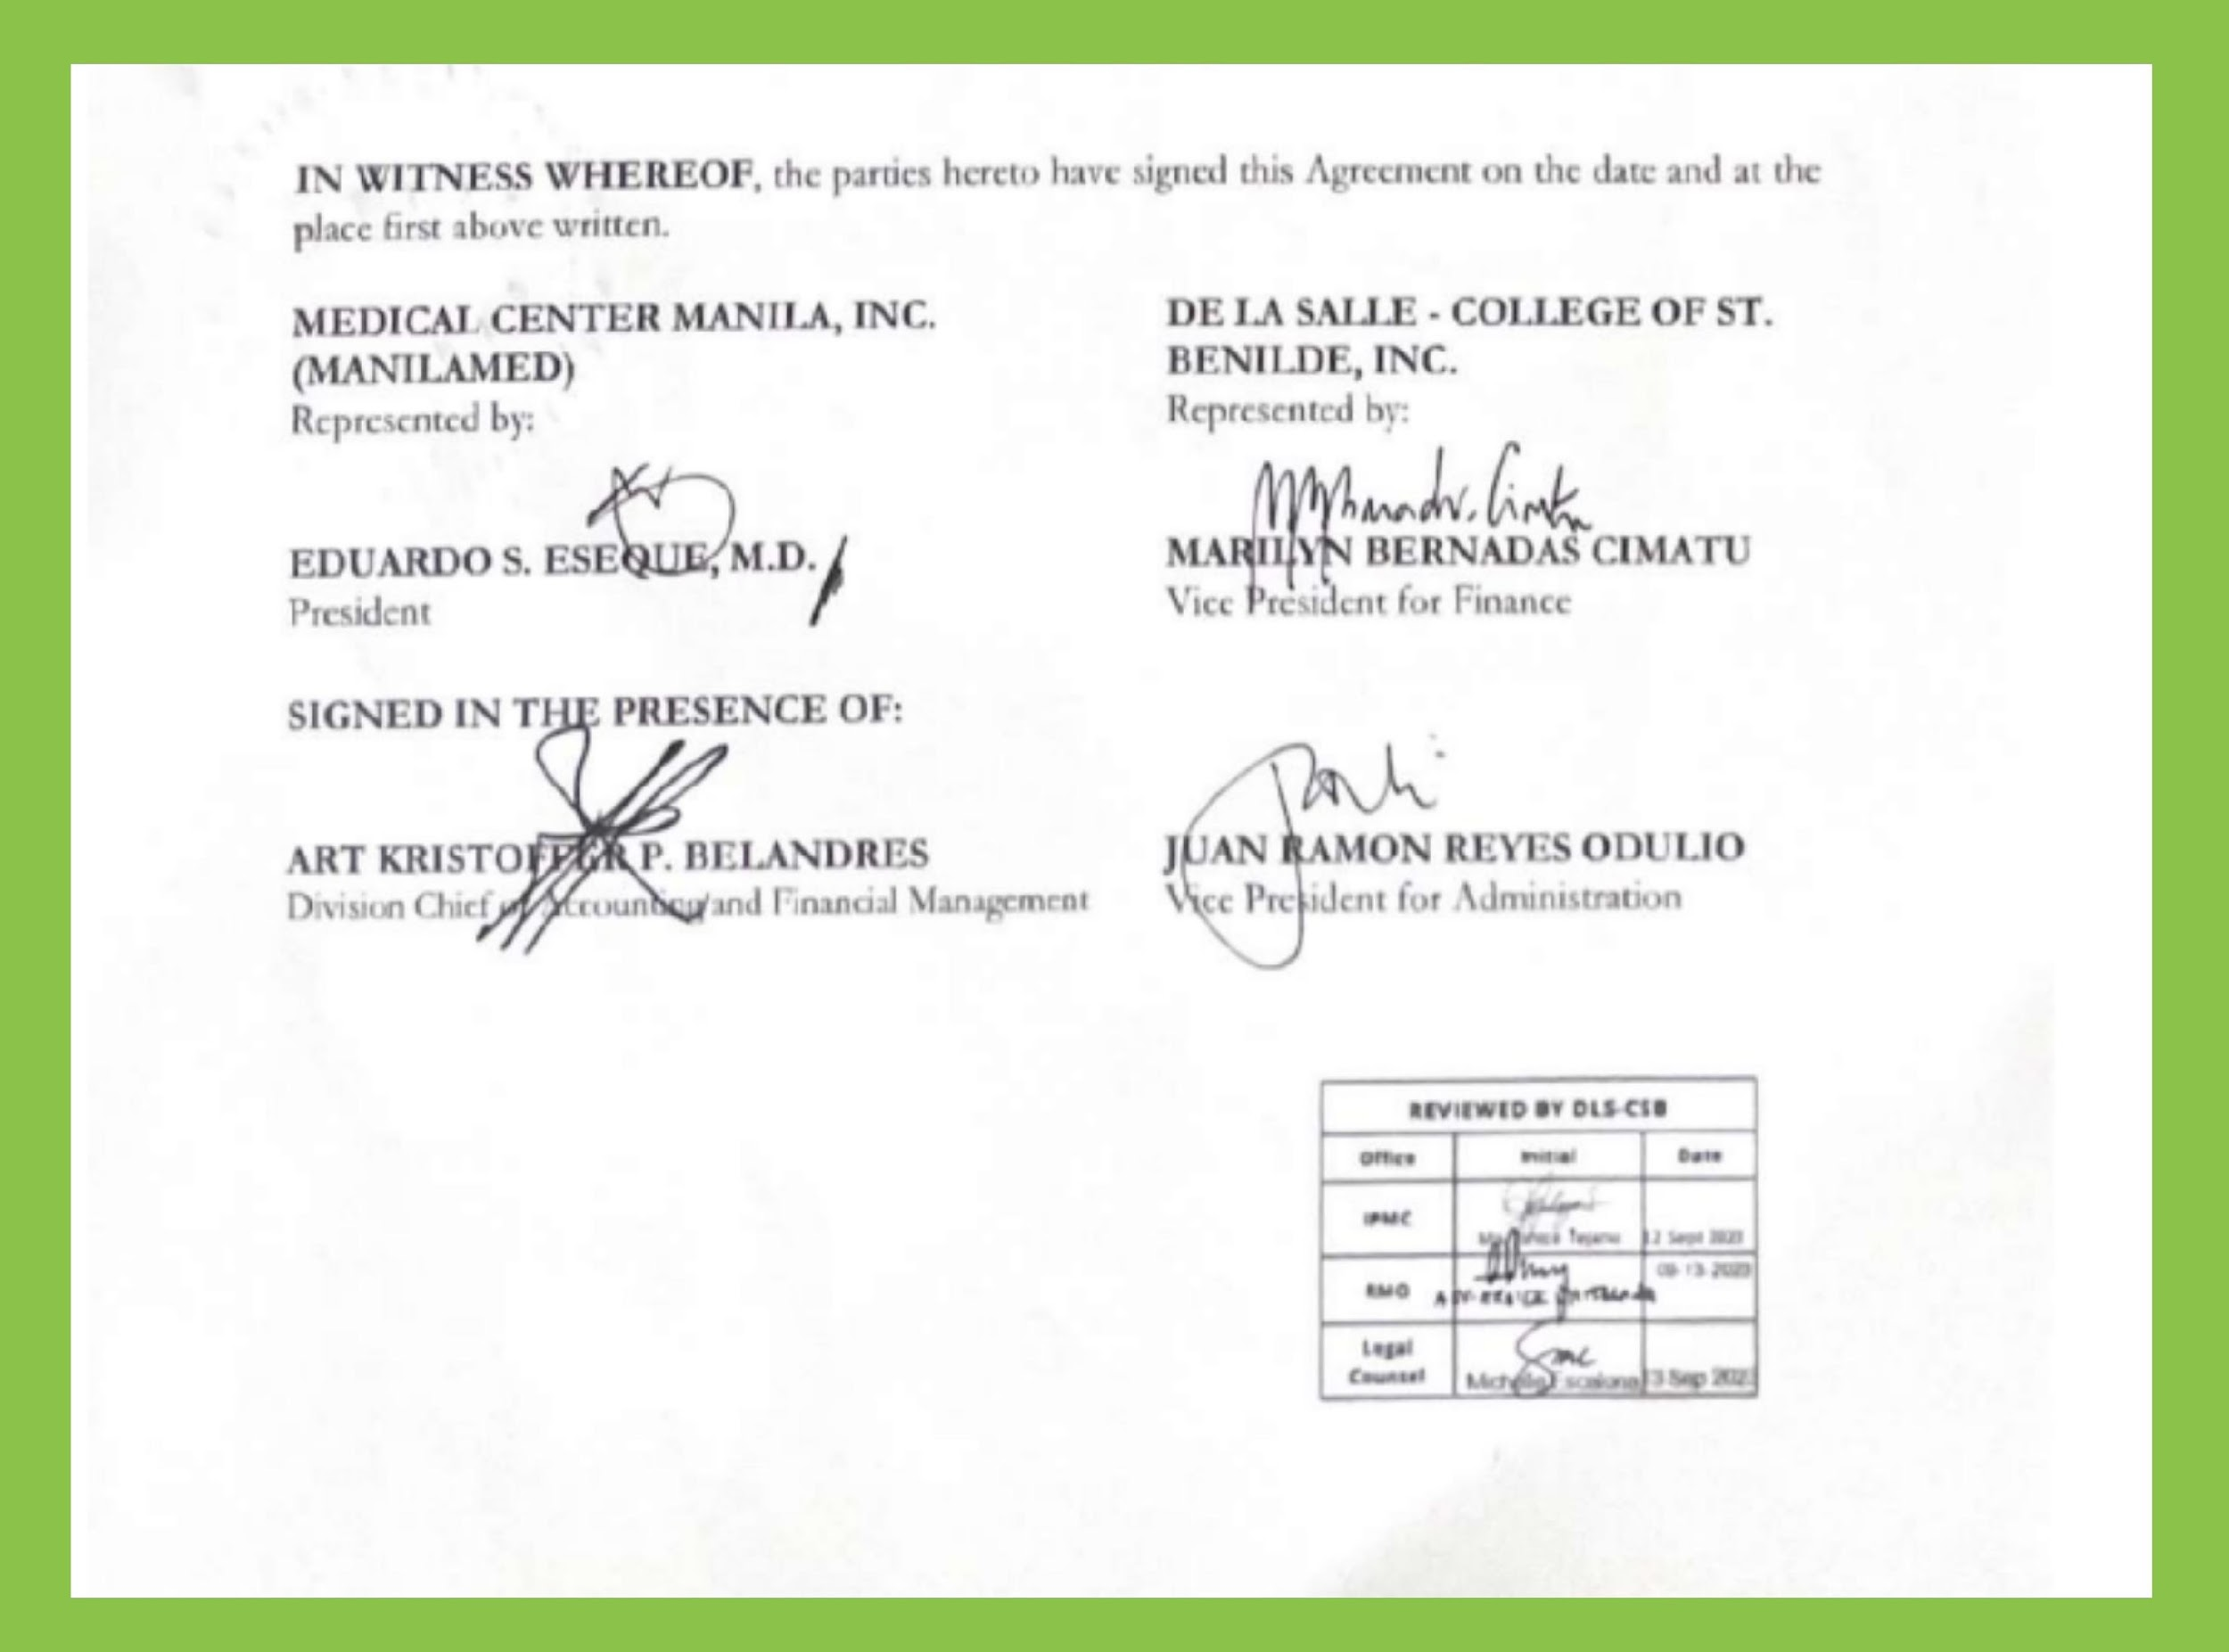
Memorandum of Agreement Manila Medical Center
This MOA refers to Manila Medical Center can now provide and render various hospital and medical services to our DLS-CSB Students and Athletes which covers the maximum amount stated to LOA and as well as to our Associates using HMO benefits.

Slide 3
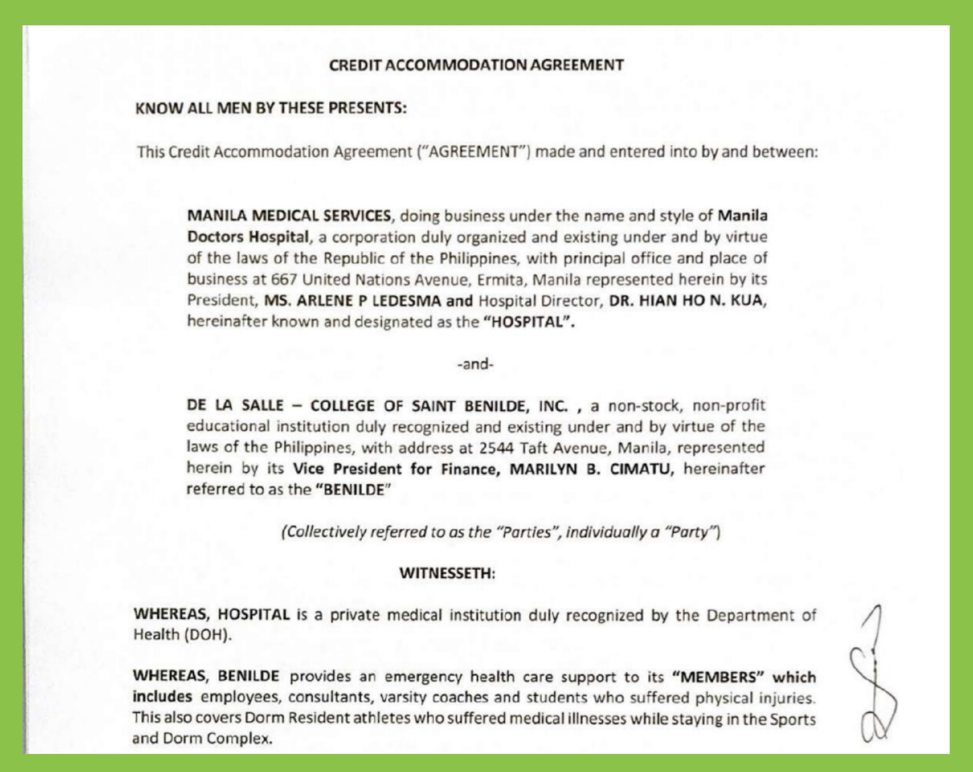
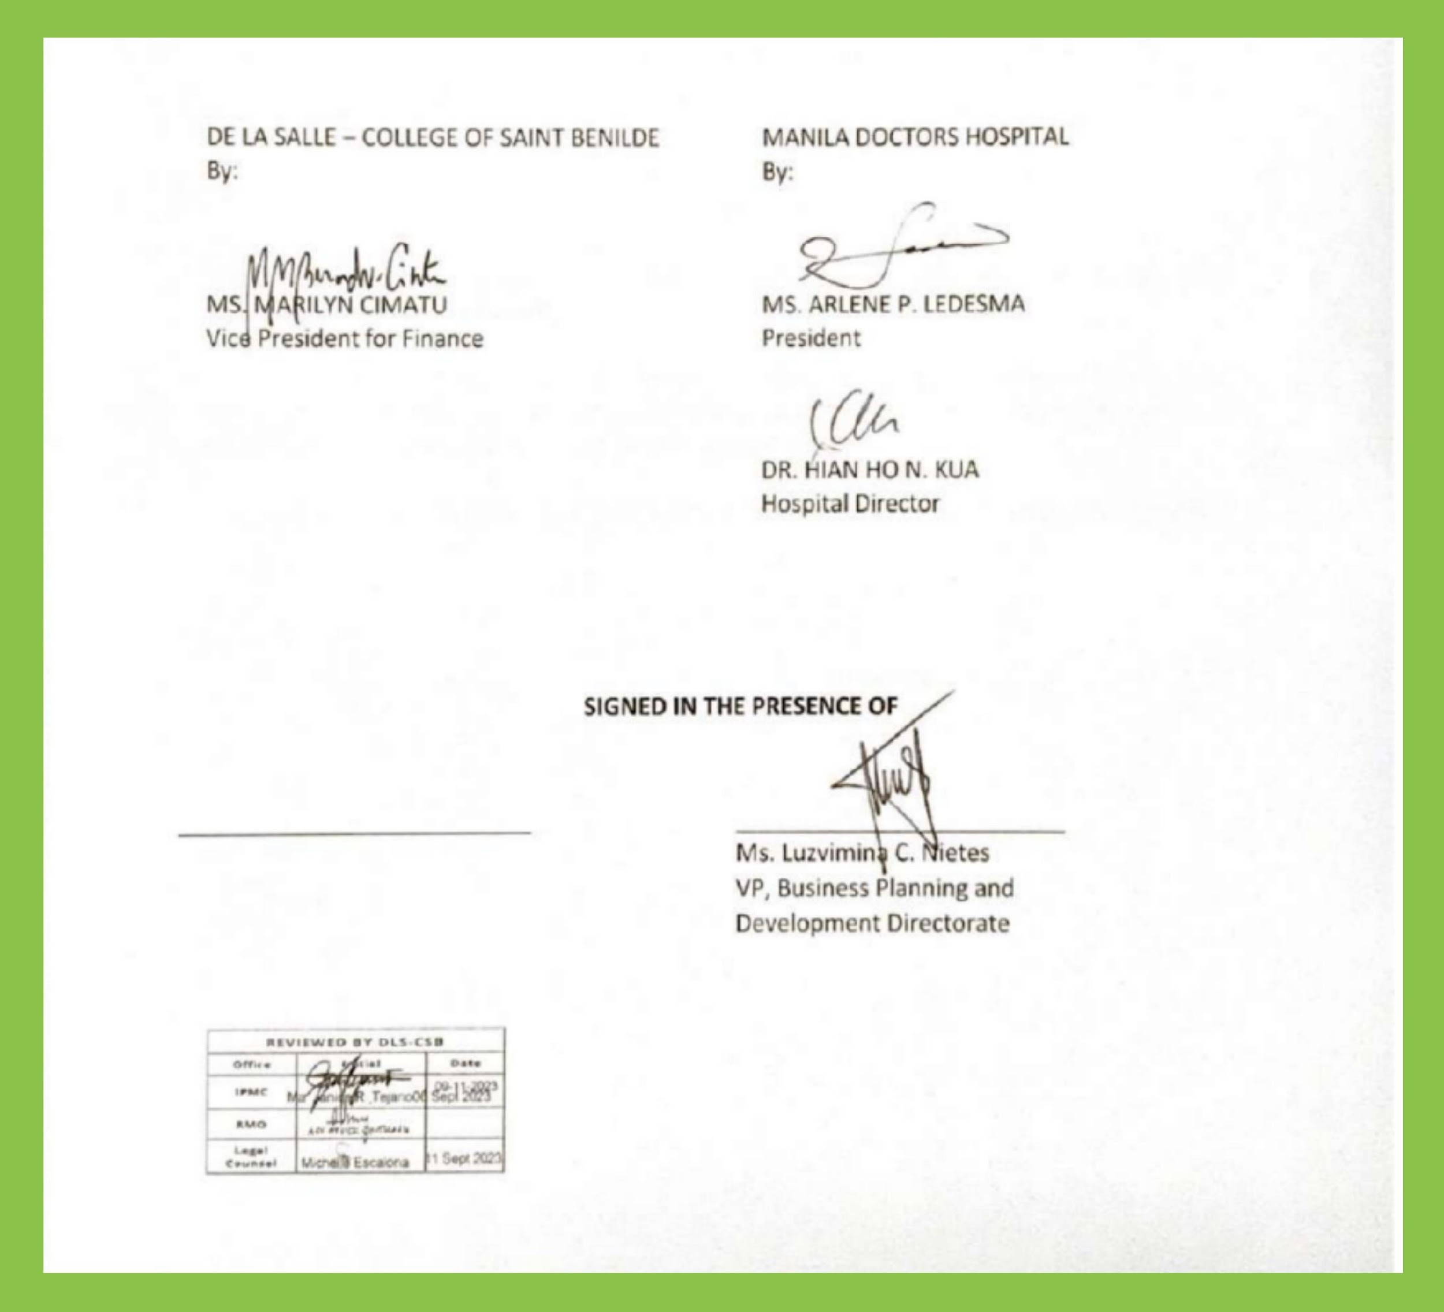
Memorandum of Agreement Manila Doctors Hospital
This MOA refers to Manila Doctors Hospital can now provide and render various hospital and medical services to our DLS-CSB Students and Athletes which covers the maximum amount stated to LOA and as well as to our Associates using HMO benefits.

Slide 4
Thank You
Prepared by:
Maria Nelda R. Casipe, RN

